Slide 1

Licenciatura en Sistemas
Taller de Tesina

Slide 2
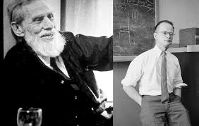
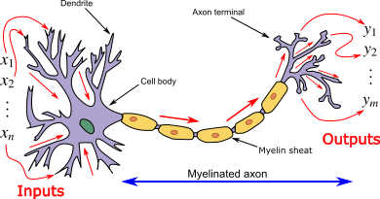
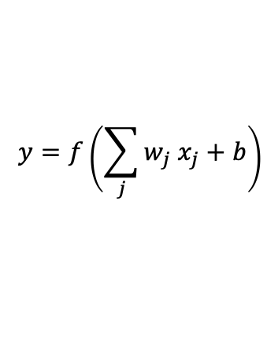
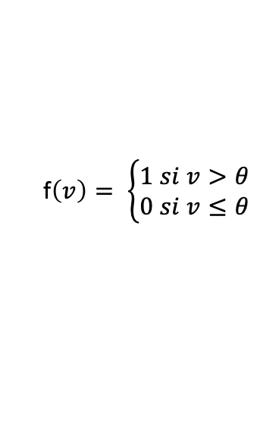
Generalidades
1943 – Warren McCulloch y Walter Pitts.
Modelo matemático de la neurona
“Because of the all-or-none character of nervous activity, neural events and the relations among them can be treated by means of propositional logic”
$$y=f\left(\sum_{j}{w_{j} x_{j}}+b\right)$$
Donde f() es una función de activación:
x1
w1
f$\left(v\right)= \left\{\begin{matrix}1 si v>θ \\ 0 si v≤θ\end{matrix}\right.$
x2
w2
f()
y
wn
xn
b

Slide 3
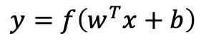
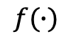
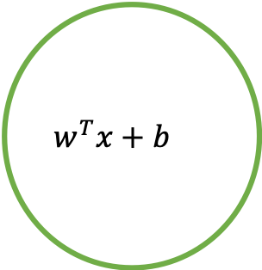
Neurona Artificial
Sinapsis
(entrada)
W1
Peso Sináptico
x1
$$w^{T}x+b$$
Soma
W2
$$y=f\left(w^{T}x+b\right)$$
Es un modelo matemático
Las sinapsis biológicas son sistemas dinámicos mucho más complejos
Lo mismo sucede en el soma neuronal.
La función de activación emula al potencial de acción neuronal, no obstante hay transmisión de información entre neuronas biológicas sin potenciales de acción.
x2
$$f(∙)$$
Axón (salida)
Wn
Función de activación
xn
b
bias

Slide 4
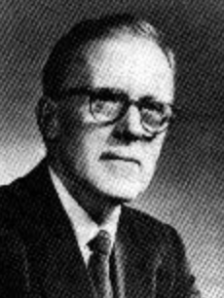
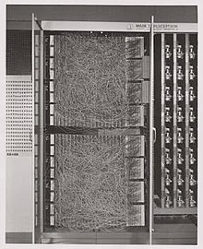
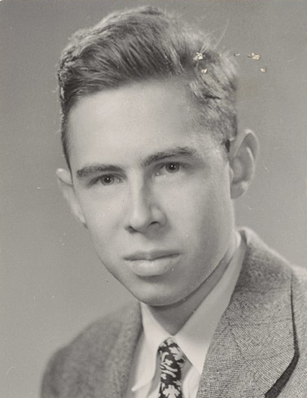
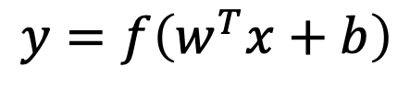
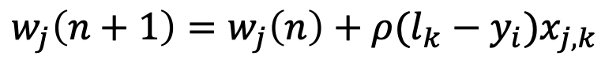



Aprendizaje
1949 – Donald Hebb : Aprendizaje Asociativo
$$y=f\left(w^{T}x+b\right)$$
No Supervisado
$$w_{i}=yx_{i}$$
$$w_{i}\left(n+1\right)=w_{i}\left(n\right)+∆w_{i}$$
$${∆w}_{i}=ηyx_{i}$$
¿Cómo definir W?
¿Cómo definir b?
1962 – Frank Rosemblatt : Perceptrón.
Supervisado
x1
w1
x2
w2
f()
$$w_{j}\left(n+1\right)=w_{j}\left(n\right)+ρ({l_{k}−y}_{i})x_{j,k}$$
y
wn
xn
b

Slide 5
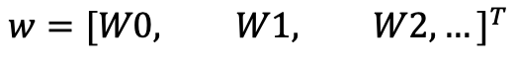
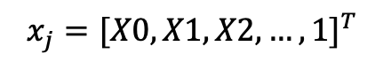
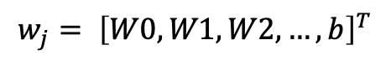
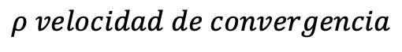
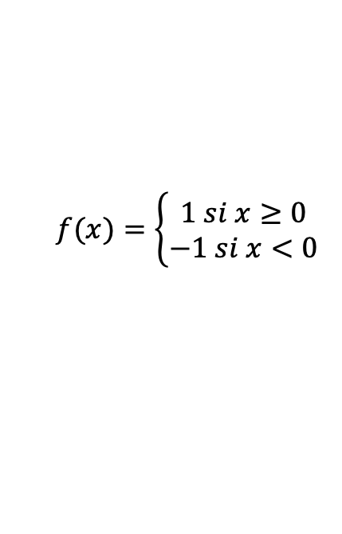
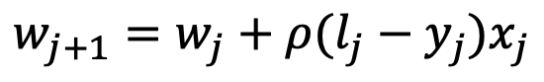
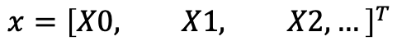
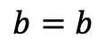
Aprendizaje
$$x={\left[X0, X1, X2,…\right]}^{T}$$
$$w={[W0, W1, W2, …]}^{T}$$
$$b=b$$
$$y=f\left(w^{T}x+b\right)$$
$$\left(w^{T}x+b\right)=W0 X0+W1 X1+W2 X2+ …+b$$
$$\left(w^{T}x+b\right)=\left[W0, W1,W2,…,b\right] {[X0, X1, X2,…, 1]}^{T}$$
$$w_{j}= {\left[W0, W1,W2,…,b\right]}^{T}$$
$$x_{j}={[X0, X1, X2,…, 1]}^{T}$$
¿Cómo definir W?
¿Cómo definir b?
$$f(x)=\left\{\begin{matrix}1 si x≥0 \\ −1 si x<0\end{matrix}\right.$$
x1
$$y=f\left({w_{j}}^{T}x_{j}\right)=f\left( \left[W0,W1,b\right]{[X0, X1, 1]}^{T}\right)$$
w1
x2
w2
f()
y
$$w_{j+1}=w_{j}+ρ({l_{j}−y}_{j})x_{j}$$
$$ρ velocidad de convergencia$$
wn
xn
b

Slide 6
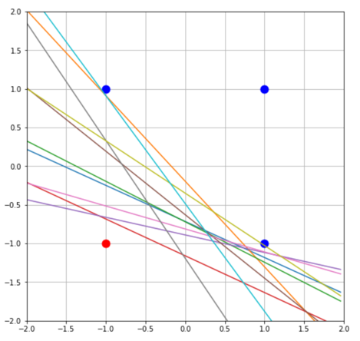
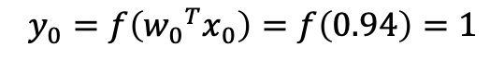
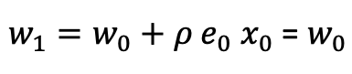
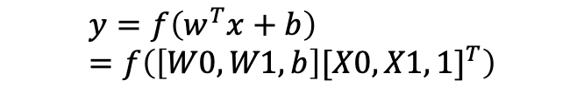
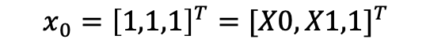
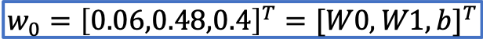
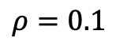
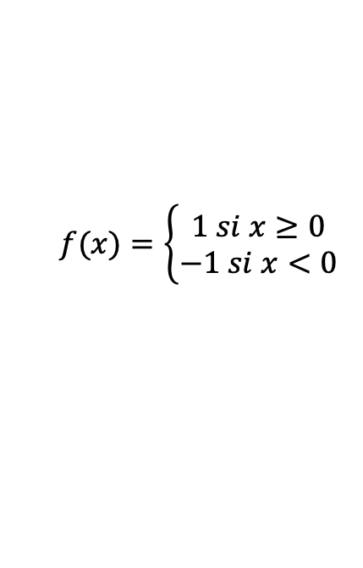
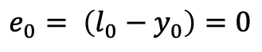
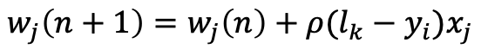
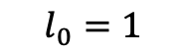
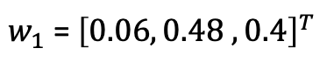
Aprendizaje
X1
Aprendizaje Supervisado en el Perceptrón.
Estado inicial aleatorio:
$$w_{0}={\left[0.06,0.48,0.4\right]}^{T}={[W0,W1,b]}^{T}$$
$$y=f\left(w^{T}x+b\right)=f\left(\left[W0,W1,b\right]{[X0, X1, 1]}^{T}\right)$$
X0
Muestra:
$$x_{0}={\left[1,1,1\right]}^{T}={[X0,X1,1]}^{T}$$
$$f(x)=\left\{\begin{matrix}1 si x≥0 \\ −1 si x<0\end{matrix}\right.$$
$$l_{0}=1$$
Estimación:
$$w_{j}\left(n+1\right)=w_{j}\left(n\right)+ρ({l_{k}−y}_{i})x_{j}$$
$$y_{0}=f\left({w_{0}}^{T}x_{0}\right)=f\left(0.94\right)=1$$
Error:
$$ρ=0.1$$
X0
X1
L
$$e_{0}= \left({l_{0}−y}_{0}\right)=0$$
-1
-1
-1
Aprendizaje (adaptación):
-1
1
1
$w_{1}=w_{0}+ρ{ e}_{0}{ x}_{0}$ = $w_{0}$
1
-1
1
$w_{1}$ = ${\left[0.06, 0.48 ,0.4\right]}^{T}$
1
1
1

Slide 7

Aprendizaje Perceptrón
X1
Aprendizaje Supervisado en el Perceptrón.
Estado inicial aleatorio:
$$w_{0}={\left[0.06,0.48,0.4\right]}^{T}={[W0,W1,b]}^{T}$$
$$y=f\left(w^{T}x+b\right)$$
X0
Muestra:
$$x_{0}={\left[1,1,1\right]}^{T}={[X0,X1,1]}^{T}$$
$$f(x)=\left\{\begin{matrix}1 si x≥0 \\ −1 si x<0\end{matrix}\right.$$
$$l_{0}=1$$
Estimación:
$$w_{j}\left(n+1\right)=w_{j}\left(n\right)+ρ({l_{k}−y}_{i})x_{j}$$
$$y_{0}=f\left({w_{0}}^{T}x_{0}\right)=f\left(0.94\right)=1$$
Error:
$$ρ=0.1$$
X0
X1
L
$$e_{0}= \left({l_{0}−y}_{0}\right)=0$$
-1
-1
-1
Aprendizaje (adaptación):
-1
1
1
$w_{1}=w_{0}+ρ{ e}_{0}{ x}_{0}$ = $w_{0}$
1
-1
1
$w_{1}$ = ${\left[0.06, 0.48 ,0.4\right]}^{T}$
1
1
1

Slide 8
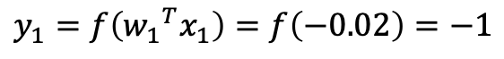
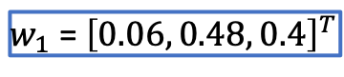
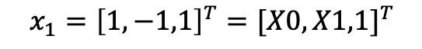
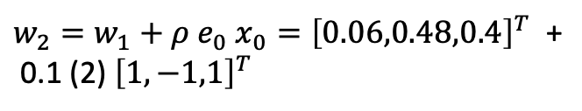
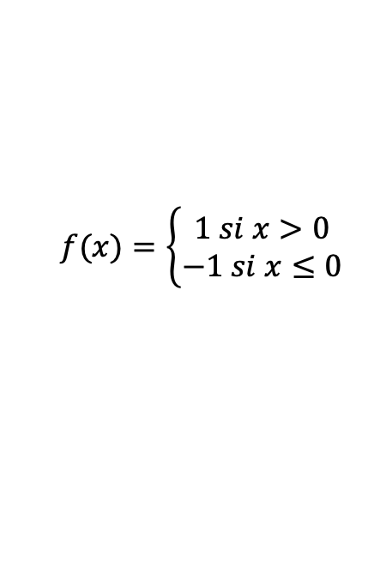
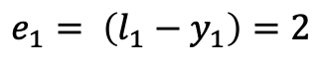

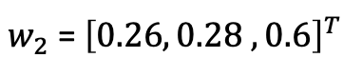
Aprendizaje Perceptrón
X1
$w_{1}$ = ${\left[0.06, 0.48, 0.4\right]}^{T}$
$$y=f\left(w^{T}x+b\right)$$
X0
Muestra:
$$x_{1}={\left[1,−1,1\right]}^{T}={[X0,X1,1]}^{T}$$
$$f(x)=\left\{\begin{matrix}1 si x>0 \\ −1 si x≤0\end{matrix}\right.$$
$$l_{1}=1$$
Estimación:
$$w_{j}\left(n+1\right)=w_{j}\left(n\right)+ρ({l_{k}−y}_{i})x_{j}$$
$$y_{1}=f\left({w_{1}}^{T}x_{1}\right)=f\left(−0.02\right)=−1$$
Error:
$$ρ=0.1$$
X0
X1
L
$$e_{1}= \left({l_{1}−y}_{1}\right)=2$$
-1
-1
-1
Aprendizaje (adaptación):
-1
1
1
$w_{2}=w_{1}+ρ{ e}_{0}{ x}_{0}={\left[0.06,0.48,0.4\right]}^{T}$ +
0.1 (2) ${\left[1,−1,1\right]}^{T}$
1
-1
1
1
1
1
$w_{2}$ = ${\left[0.26, 0.28 ,0.6\right]}^{T}$

Slide 9
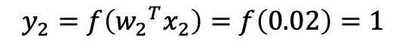
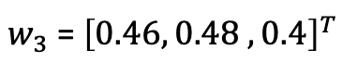
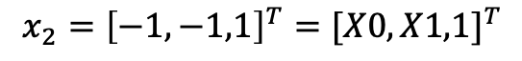
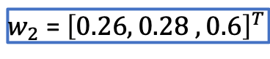
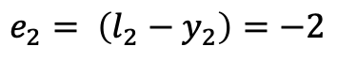
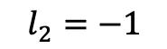
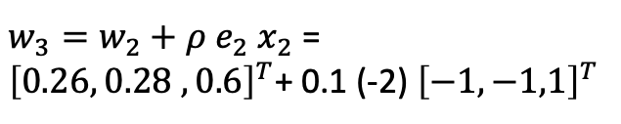
Aprendizaje Perceptrón
X1
$w_{2}$ = ${\left[0.26, 0.28 ,0.6\right]}^{T}$
$$y=f\left(w^{T}x+b\right)$$
X0
Muestra:
$$x_{2}={\left[−1, −1,1\right]}^{T}={[X0,X1,1]}^{T}$$
$$f(x)=\left\{\begin{matrix}1 si x>0 \\ −1 si x≤0\end{matrix}\right.$$
$$l_{2}=−1$$
Estimación:
$$w_{j}\left(n+1\right)=w_{j}\left(n\right)+ρ({l_{k}−y}_{i})x_{j}$$
$$y_{2}=f\left({w_{2}}^{T}x_{2}\right)=f\left(0.02\right)=1$$
Error:
$$ρ=0.1$$
X0
X1
L
$$e_{2}= \left({l_{2}−y}_{2}\right)=−2$$
-1
-1
-1
Aprendizaje (adaptación):
-1
1
1
$w_{3}=w_{2}+ρ{ e}_{2}{ x}_{2}$ =
${\left[0.26, 0.28 ,0.6\right]}^{T}$+ 0.1 (-2) ${\left[−1,−1,1\right]}^{T}$
1
-1
1
1
1
1
$w_{3}$ = ${\left[0.46, 0.48 ,0.4\right]}^{T}$

Slide 10
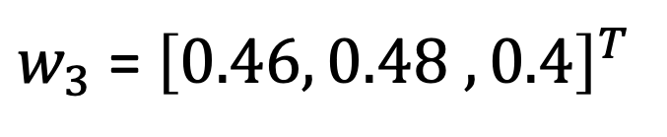
Aprendizaje Perceptrón
X1
$w_{2}$ = ${\left[0.26, 0.28 ,0.6\right]}^{T}$
$$y=f\left(w^{T}x+b\right)$$
X0
Muestra:
$$x_{2}={\left[−1, −1,1\right]}^{T}={[X0,X1,1]}^{T}$$
$$f(x)=\left\{\begin{matrix}1 si x>0 \\ −1 si x≤0\end{matrix}\right.$$
$$l_{2}=−1$$
Estimación:
$$w_{j}\left(n+1\right)=w_{j}\left(n\right)+ρ({l_{k}−y}_{i})x_{j}$$
$$y_{2}=f\left({w_{2}}^{T}x_{2}\right)=f\left(0.02\right)=1$$
Error:
$$ρ=0.1$$
X0
X1
L
$$e_{2}= \left({l_{2}−y}_{2}\right)=−2$$
-1
-1
-1
Aprendizaje (adaptación):
-1
1
1
$w_{3}=w_{2}+ρ{ e}_{2}{ x}_{2}$ =
${\left[0.26, 0.28 ,0.6\right]}^{T}$+ 0.1 (-2) ${\left[−1,−1,1\right]}^{T}$
1
-1
1
1
1
1
$w_{3}$ = ${\left[0.46, 0.48 ,0.4\right]}^{T}$

Slide 11
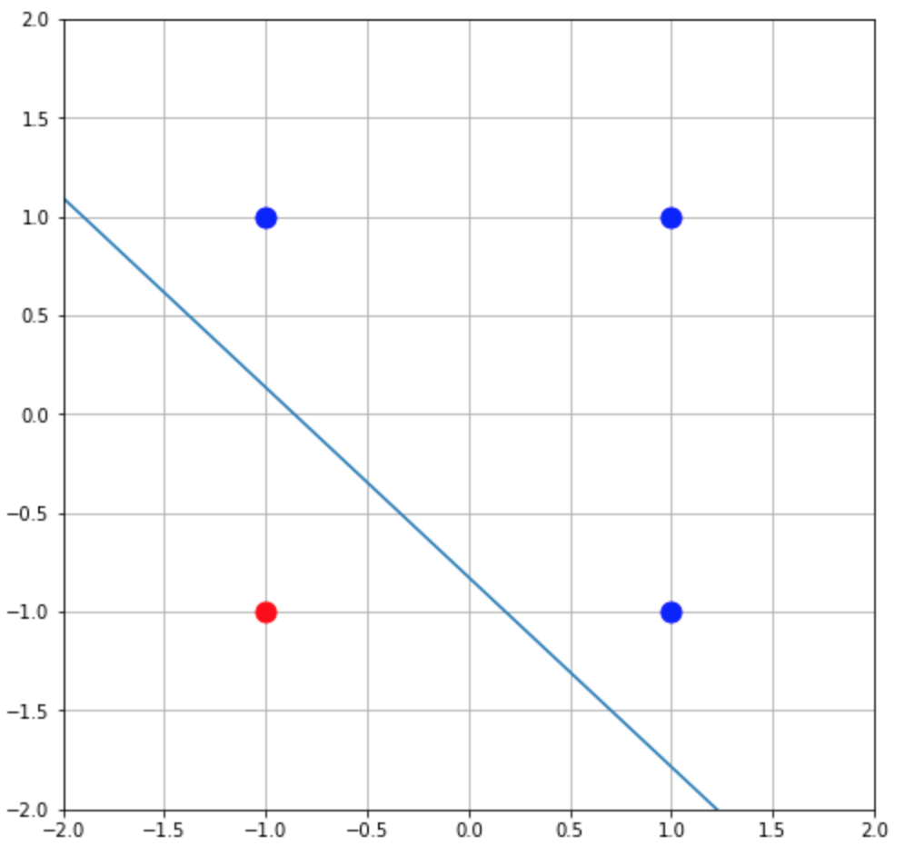
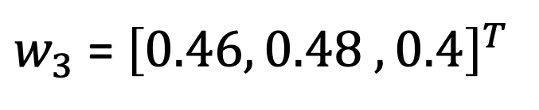
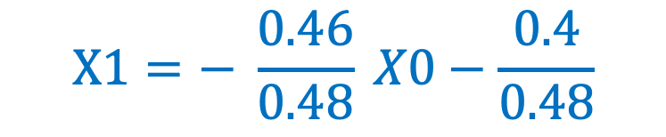


Aprendizaje Perceptrón
X1
$w_{3}$ = ${\left[0.46, 0.48 ,0.4\right]}^{T}$
$$y=f\left(w^{T}x+b\right)$$
X0
Hiperplano de clasificación:
$$f(x)=\left\{\begin{matrix}1 si x>0 \\ −1 si x≤0\end{matrix}\right.$$
$$w^{T}x+b={w_{3}}^{T} \left[X0, X1, 1\right]=0$$
$$w_{j}\left(n+1\right)=w_{j}\left(n\right)+ρ({l_{k}−y}_{i})x_{j}$$
$$0.46 X0+0.48 X1+0.4=0$$
L
$$ρ=0.1$$
X0
X1
$$X1=− \frac{0.46}{0.48} X0−\frac{0.4}{0.48}$$
-1
-1
-1
-1
1
1
1
-1
1
1
1
1

Slide 12

Aprendizaje Perceptrón

Slide 13





Back - propagation
Redes multicapas – Perceptrón Multicapa
Datos de entrada y etiquetas de entrenamiento
$$ξ^{μ}={\left[ξ_{1},ξ_{2},⋯,ξ_{k},⋯\right]}^{μ}↔λ^{μ}={\left[λ_{1},λ_{2}\right]}^{μ}$$
Salida Nivel oculto
$V_{j}=$ $f\left(\sum_{k}{w_{jk}ξ_{k}}\right)$
$f\left(.\right)$ es una función diferenciable
Salida de la Red
$$O_{i}=f\left(\sum_{j}{W_{ij}f\left(\sum_{k}{w_{jk}ξ_{k}}\right)}\right)$$
Error cuadrático
$$E\left(W_{ij}{,w}_{jk}\right)=\frac{1}{2}\sum_{μi}{{\left\|λ_{i}^{μ}−O_{i}^{μ}\right\|}^{2}}$$

Slide 14



Back - propagation
¿W?
Obtener los parámetros $W_{ij}{,w}_{jk}$ tal que el error,
$$E\left(W_{ij}{,w}_{jk}\right)=\frac{1}{2}\sum_{μi}{{\left\|λ_{i}^{μ}−O_{i}^{μ}\right\|}^{2}}$$
sea mínimo.
Obtener los parámetros $W_{ij}{,w}_{jk}$ tal que la función de loss,
$$L\left(W_{ij}{,w}_{jk}\right)=E\left(W_{ij}{,w}_{jk}\right)+\sum{{\left\|W\right\|}^{2}}=\frac{1}{2}\sum_{μi}{{\left\|λ_{i}^{μ}−O_{i}^{μ}\right\|}^{2}}++\sum{{\left\|W\right\|}^{2}}$$
sea mínima.
¿Cómo?

Slide 15
Back - propagation
¿W?
Obtener los parámetros $W_{ij}{,w}_{jk}$ tal que el error,
$$E\left(W_{ij}{,w}_{jk}\right)=\frac{1}{2}\sum_{μi}{{\left\|λ_{i}^{μ}−O_{i}^{μ}\right\|}^{2}}$$
sea mínimo.
Obtener los parámetros $W_{ij}{,w}_{jk}$ tal que la función de loss,
$$L\left(W_{ij}{,w}_{jk}\right)=E\left(W_{ij}{,w}_{jk}\right)+\sum{{\left\|W\right\|}^{2}}=\frac{1}{2}\sum_{μi}{{\left\|λ_{i}^{μ}−O_{i}^{μ}\right\|}^{2}}++\sum{{\left\|W\right\|}^{2}}$$
sea mínima.
¿Cómo?

Slide 16



Repaso
Gradiente de una Función
$$∇f\left(x_{0 },x_{1 },x_{2 },…\right)=\frac{∂f}{∂x_{i}}$$

Slide 17


Repaso
Gradiente Descendente
$$∇f\left(x_{0 },x_{1 },x_{2 },…\right)=−\frac{∂f}{∂x_{i}}$$

Slide 18





Back - propagation
Gradiente descendente
$$E\left(w\right)=\frac{1}{2}\sum_{iμ}{{\left\|λ_{i}^{μ}−O_{i}^{μ}\right\|}^{2}}$$
$${∆W}_{ij}=−η\frac{∂E}{∂W_{ij}}$$
$${∆w}_{jk}=−η\frac{∂E}{∂w_{jk}}$$
$${W_{ij}\left(n+1\right)= W_{ij}\left(n\right)+∆W}_{ij}$$
$${w_{jk}\left(n+1\right)= w_{jk}\left(n\right)+∆w}_{jk}$$

Slide 19
Back - propagation
Backpropagation

Slide 20







Back - propagation
$$E\left(w\right)=\frac{1}{2}\sum_{iμ}{{\left\|λ_{i}^{μ}−O_{i}^{μ}\right\|}^{2}}$$
$$O_{i}=f\left(\sum_{j}{W_{ij}V_{j}}\right)$$
$V_{j}=$ $f\left(\sum_{k}{w_{jk}ξ_{k}}\right)$
$${∆W}_{ij}=−η\frac{∂E}{∂W_{ij}}$$
$${∆w}_{jk}=−η\frac{∂E}{∂w_{jk}}=−η\sum_{μ}{\frac{∂E}{∂V_{j}}\frac{∂V_{j}}{∂w_{jk}}}$$
$${∆W}_{ij}=η\sum_{μ}{\left(λ_{i}^{μ}−O_{i}^{μ}\right)f^{′}\left(∙\right)V_{j}}$$
$${∆w}_{jk}=η\sum_{μ}{\sum_{i}{\left(λ_{i}^{μ}−O_{i}^{μ}\right)f^{′}\left(∙_{i}\right)W_{ij}f^{′}\left(∙_{j}\right)ξ_{j}}}$$

Slide 21



Back - propagation
$$E\left(w\right)=\frac{1}{2}\sum_{iμ}{{\left\|λ_{i}^{μ}−O_{i}^{μ}\right\|}^{2}}$$
$$O_{i}=f\left(\sum_{j}{W_{ij}V_{j}}\right)$$
$V_{j}=$ $f\left(\sum_{k}{w_{jk}ξ_{k}}\right)$
$${∆W}_{ij}=−η\frac{∂E}{∂W_{ij}}$$
$${∆w}_{jk}=−η\frac{∂E}{∂w_{jk}}=−η\sum_{μ}{\frac{∂E}{∂V_{j}}\frac{∂V_{j}}{∂w_{jk}}}$$
$${∆W}_{ij}=η\sum_{μ}{\left(λ_{i}^{μ}−O_{i}^{μ}\right)f^{′}\left(∙\right)V_{j}}$$
$${∆w}_{jk}=η\sum_{μ}{\sum_{i}{\left(λ_{i}^{μ}−O_{i}^{μ}\right)f^{′}\left(∙_{i}\right)W_{ij}f^{′}\left(∙_{j}\right)ξ_{j}}}$$
$${∆W}_{ij}=η\sum_{μ}{\left(λ_{i}^{μ}−O_{i}^{μ}\right)f^{′}\left(∙_{i}\right)V_{j}}$$
$${∆w}_{jk}=η\sum_{μ}{f^{′}\left(∙_{j}\right)ξ_{j}\sum_{i}{\left(λ_{i}^{μ}−O_{i}^{μ}\right)f^{′}\left(∙_{i}\right)W_{ij}}}$$

Slide 22

Back - propagation
$$E\left(w\right)=\frac{1}{2}\sum_{iμ}{{\left\|λ_{i}^{μ}−O_{i}^{μ}\right\|}^{2}}$$
$$O_{i}=f\left(\sum_{j}{W_{ij}V_{j}}\right)$$
$V_{j}=$ $f\left(\sum_{k}{w_{jk}ξ_{k}}\right)$
$${∆W}_{ij}=−η\frac{∂E}{∂W_{ij}}$$
$${∆w}_{jk}=−η\frac{∂E}{∂w_{jk}}=−η\sum_{μ}{\frac{∂E}{∂V_{j}}\frac{∂V_{j}}{∂w_{jk}}}$$
$${∆W}_{ij}=η\sum_{μ}{\left(λ_{i}^{μ}−O_{i}^{μ}\right)f^{′}\left(∙\right)V_{j}}$$
$${∆w}_{jk}=η\sum_{μ}{\sum_{i}{\left(λ_{i}^{μ}−O_{i}^{μ}\right)f^{′}\left(∙_{i}\right)W_{ij}f^{′}\left(∙_{j}\right)ξ_{j}}}$$
$${∆W}_{ij}=η\sum_{μ}{\left(λ_{i}^{μ}−O_{i}^{μ}\right)f^{′}\left(∙_{i}\right)V_{j}}$$
$${∆w}_{jk}=η\sum_{μ}{f^{′}\left(∙_{j}\right)ξ_{j}\sum_{i}{\left(λ_{i}^{μ}−O_{i}^{μ}\right)f^{′}\left(∙_{i}\right)W_{ij}}}$$

Slide 23







Back - propagation
$${∆W}_{ij}=η\sum_{μ}{\left(λ_{i}^{μ}−O_{i}^{μ}\right)f^{′}\left(∙_{i}\right)V_{j}}$$
$$δ_{i}=\left(λ_{i}^{μ}−O_{i}^{μ}\right)f^{′}\left(∙_{i}\right)$$
$${∆w}_{jk}=η\sum_{μ}{f^{′}\left(∙_{j}\right)ξ_{k}\sum_{i}{\left(λ_{i}^{μ}−O_{i}^{μ}\right)f^{′}\left(∙_{i}\right)W_{ij}}}$$
$$δ_{j}=f^{′}\left(∙_{j}\right)\sum_{i}{δ_{i}W_{ij}}$$
$${∆W}_{ij}=η\sum_{μ}{δ_{i}V_{j}}$$
$${∆w}_{jk}=η\sum_{μ}{δ_{j}ξ_{k}}$$

Slide 24





Back - propagation
Back - Propagation
1986 – David Rumelhart: Back-Propagation aplicado a redes
de neuronas artificiales
$$δ_{i}=\left(λ_{i}^{μ}−O_{i}^{μ}\right)f^{′}\left(∙_{i}\right)$$
$$δ_{j}=f^{′}\left(∙_{j}\right)\sum_{i}{δ_{i}W_{ij}}$$
$${∆W}_{ij}=η\sum_{μ}{δ_{i}V_{j}}$$
$${∆w}_{jk}=η\sum_{μ}{δ_{j}ξ_{k}}$$

Slide 25


Funciones de Activación
$$f : y=f\left(w^{T}x+b\right)$$

Slide 26







Funciones de Activación – Desvanecimiento del gradiente
Backpropagation y …
SIGMOIDEA
$$f\left(x\right)=\frac{1}{1+e^{−x}}$$
$$f^{′}\left(x\right)=f\left(x\right)∗(1−f\left(x\right))$$
$$δ_{i}=\left(λ_{i}^{μ}−O_{i}^{μ}\right)f^{′}\left(∙_{i}\right)$$
$δ_{j}=f^{′}\left(∙_{j}\right)\sum_{i}{δ_{i}W_{ij}}= \sum_{i}{f^{′}\left(∙_{j}\right)}$ $f^{′}\left(∙_{i}\right)$ $\left(λ_{i}^{μ}−O_{i}^{μ}\right)W_{ij}$
6 layers
30 layers

Slide 27



Funciones de Activación – Desvanecimiento del gradiente
Backpropagation y …
ReLU – ELU las más usadas en Aprendizaje Profundo
$${f^{′}}_{RELU}\left(x\right)=\left\{\begin{matrix}1 x>0 \\ 0 x<0\end{matrix}\right.$$
$$f_{ReLU}\left(x\right)=max(0,x)$$
1
$$δ_{i}=\left(λ_{i}^{μ}−O_{i}^{μ}\right)f^{′}\left(∙_{i}\right)$$
$δ_{j}=f^{′}\left(∙_{j}\right)\sum_{i}{δ_{i}W_{ij}}= \sum_{i}{f^{′}\left(∙_{j}\right)}$ $f^{′}\left(∙_{i}\right)$ $\left(λ_{i}^{μ}−O_{i}^{μ}\right)W_{ij}$
6 layers
30 layers

Slide 28







Ejemplo – Back - Propagation
A
Calcular:
$$\frac{∂F}{∂A}$$
$$\frac{∂F}{∂B}$$
$$\frac{∂F}{∂C}$$
+
D
B
E
RELU
F
C
*
A=1 B=-2 C = -3
$${∆W}_{ij}=η\sum_{μ}{δ_{i}V_{j}}$$
$${∆w}_{jk}=η\sum_{μ}{δ_{j}ξ_{k}}$$
$$δ_{j}=f^{′}\left(∙_{j}\right)\sum_{i}{δ_{i}W_{ij}}$$
$$δ_{i}=\left(λ_{i}^{μ}−O_{i}^{μ}\right)f^{′}\left(∙_{i}\right)$$

Slide 29








Ejemplo – Back - Propagation
A
(1)
Calcular:
$$\frac{∂F}{∂A}$$
$$\frac{∂F}{∂B}$$
$$\frac{∂F}{∂C}$$
(-2)
+
B
D
(-1)
(-3)
E
(3)
RELU
F
(3)
C
*
A=1 B=-2 C = -3
$$\frac{∂F}{∂E}=1$$
$\frac{∂F}{∂A}=\frac{∂F}{∂E} \frac{∂E}{∂D} \frac{∂D}{∂A}$
$$\frac{∂E}{∂C}=D$$
$$\frac{∂E}{∂D}=C$$
$\frac{∂F}{∂B}=\frac{∂F}{∂E} \frac{∂E}{∂D} \frac{∂D}{∂B}$
$$\frac{∂D}{∂A}=1$$
$$\frac{∂D}{∂B}=1$$
$\frac{∂F}{∂C}=\frac{∂F}{∂E} \frac{∂E}{∂C}$

Slide 30



Ejemplo – Back - Propagation
A
(1)
(-3)
Calcular:
(-3)
(-3)
$$\frac{∂F}{∂A}$$
$$\frac{∂F}{∂B}$$
$$\frac{∂F}{∂C}$$
(-2)
+
B
D
(-1)
(-3)
E
(3)
RELU
F
(3)
C
*
A=1 B=-2 C = -3
(-1)
(1)
(1)
$$\frac{∂F}{∂E}=1$$
$\frac{∂F}{∂A}=\frac{∂F}{∂E} \frac{∂E}{∂D} \frac{∂D}{∂A}$ = C = -3
$$\frac{∂E}{∂C}=D$$
$$\frac{∂E}{∂D}=C$$
$\frac{∂F}{∂B}=\frac{∂F}{∂E} \frac{∂E}{∂D} \frac{∂D}{∂B}$ = C = -3
$$\frac{∂D}{∂A}=1$$
$$\frac{∂D}{∂B}=1$$
$\frac{∂F}{∂C}=\frac{∂F}{∂E} \frac{∂E}{∂C}$= D = -1

Slide 31
Preguntas
Gracias

